Slide 1
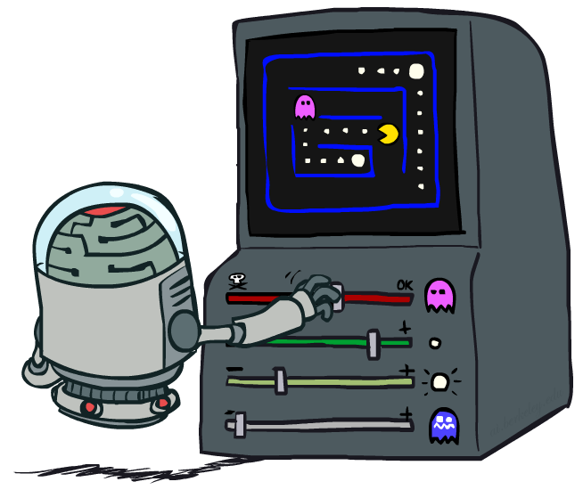
Reinforcement Learning Wrap-up
Slides courtesy of Dan Klein and Pieter Abbeel – University of California, Berkeley
[These slides were created by Dan Klein and Pieter Abbeel for CS188 Intro to AI at UC Berkeley. All CS188 materials are available at http://ai.berkeley.edu.]
Notes:
Please retain proper attribution and the reference to ai.berkeley.edu. Thanks!

Slide 2
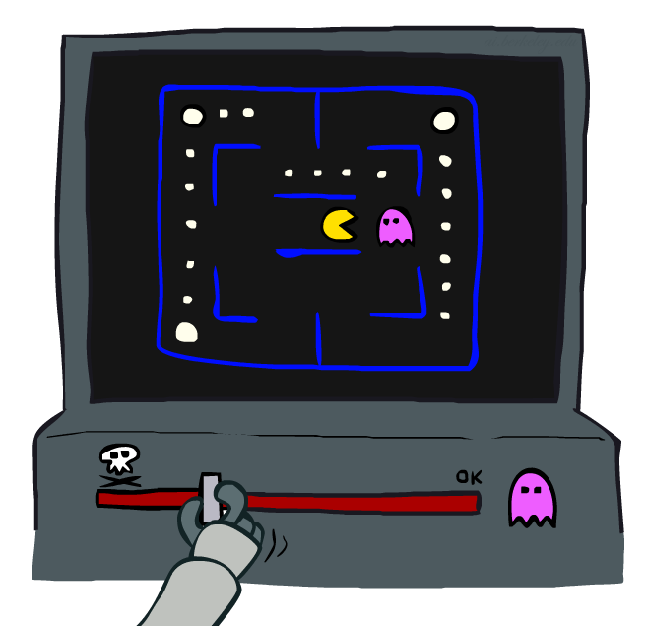
Review: Approximate Q-Learning
Notes:
What do you do in a game like PacMan when there are so many states, that you can’t possibly learn about every one.
The basic idea is called approximate Q-Learning. When you learn that a ghost is bad, you should transfer that to other states that have ghosts.

Slide 3
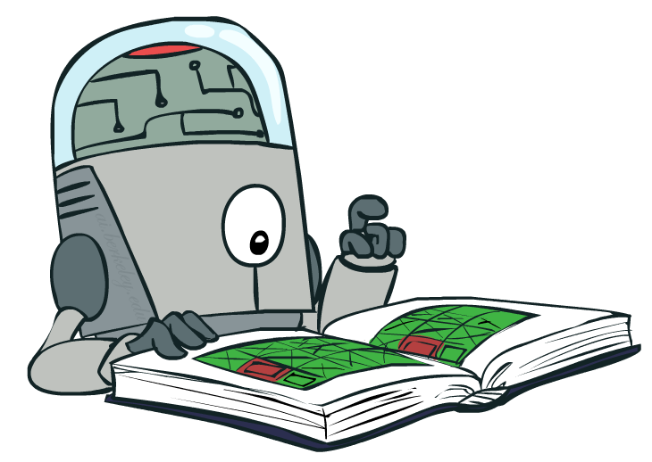
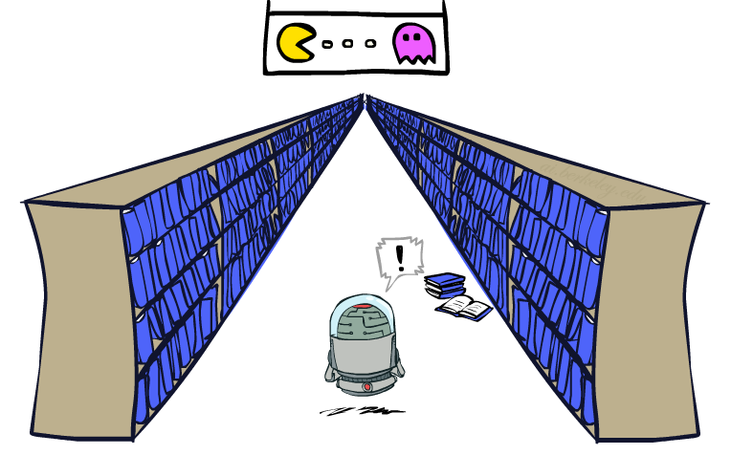
Review: Generalizing Across States
Basic Q-Learning keeps a table of all q-values
In realistic situations, we cannot possibly learn about every single state!
Too many states to visit them all in training
Too many states to hold the q-tables in memory
Instead, we want to generalize:
Learn about some small number of training states from experience
Generalize that experience to new, similar situations
This is a fundamental idea in machine learning, and we’ll see it over and over again
[demo – RL pacman]
Notes:
For ever cell and every action, you’ve got a table of values that you’re storing.
The problem is that for games like PackMan there are too many states to hold in memory, so many that you can’t hold them all in memory.
Instead, we want to generalize. This is a fundamental idea in machine learning.
You want to be able to generalize not just to save on time and storage, but because it’s better. You’re going to learn faster through generalization.

Slide 4
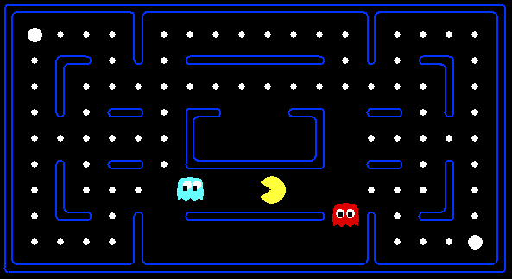
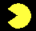


Review: Pacman Example
Let’s say we discover through experience that this state is bad:
In naïve q-learning, we know nothing about this state:
Or even this one!
[Demo: Q-learning – pacman – tiny – watch all (L11D5)]
[Demo: Q-learning – pacman – tiny – silent train (L11D6)]
[Demo: Q-learning – pacman – tricky – watch all (L11D7)]
Notes:
#2 is a different state, and in Naieve q-learning you know nothing about it, even though it looks like the same situation just on a different position in the board.
You also know nothing about #3, which only differs based on one dot. That’s a completely different state! We have to learn about it separately!

Slide 5
Feature-Based Representations
Solution: describe a state using a vector of features (properties)
Features are functions from states to real numbers (often 0/1) that capture important properties of the state
Example features:
Distance to closest ghost
Distance to closest dot
Number of ghosts
1 / (dist to dot)²
Is Pacman in a tunnel? (0/1)
…… etc.
Is it the exact state on this slide?
Can also describe a q-state (s, a) with features (e.g. action moves closer to food)
Notes:
So what’s the solution? The solution is to take a state, and rather than taking it as its own black box, whose values are separate from all others, we’re going to treat it as a vector of features – just like with evaluation functions.
…
Is PacMan in a tunnel, We could learn that this is dangerous.
We could even do “Is it the exact same state as this”, but that would lead to millions of features.
Just like with evaluation functions, we’re going to represent the state as a set as a weighted linear combination of the feature values.

Slide 6
Flashback: Evaluation Functions
Evaluation functions score non-terminals in depth-limited search
Ideal function: returns the actual minimax value of the position
In practice: typically weighted linear sum of features:
e.g. f₁(s) = (num white queens – num black queens), etc.

Slide 7
Linear Value Functions
Using a feature representation, we can write a q function (or value function) for any state using a few weights:
Advantage: our experience is summed up in a few powerful numbers
Disadvantage: states may share features but actually be very different in value!
Notes:
This gives us linear value functions.
For state evaluation we had V(s), like what we did for Chess.
For reinforcement learning, we do Q(S,A), where we’re evaluating the actions as well as the state.
We’ll allow the learning algorithm to set the weights automatically.

Slide 8

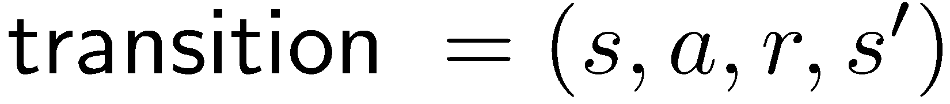
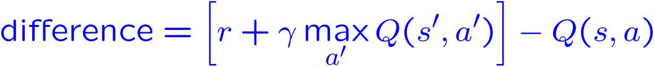
Approximate Q-Learning
Q-learning with linear Q-functions:
Intuitive interpretation:
Adjust weights of active features
E.g., if something unexpectedly bad happens, blame the features that were on: disprefer all states with that state’s features
Formal justification: online least squares
Exact Q’s
Approximate Q’s
Notes:
Here’s the magic equation for approximate q-learning.
I give you the state and the action, and out pops the value.
So how do we do learning with this type of Q function?
The first part of the learning algorithm doesn’t actually care where the Q value came from. It says, give me a transition so that I can learn.
We then take a difference. I thought that we were going to get Q(S,A0. I now think that I’m going to this reward, plus some discounted future reward. So the difference is essentially an ERROR TERM. It’s the difference between what we thought we would get and what we seemed to be about to get on the basis of the this one step ahead experience.
For an exact inference it’s this. This is just the algebraic re-write of taking alpha of one, and 1-alpha of the other.
Basically what we do is we keep our Q value around, and then nudge it in the direction of who we were wrong.
It would be really easy to update this value if we were storing Q values in a table. However, now we’re strong Q values as a linear sum, and the only parameters we can adjust are the weights.
If we determine that my Q value wasn’t high enough for this state, then we need to change the weights to make it higher.
The way that we do that is to increase the weights? Which ones? All of them, but in proportion to the feature value. If it’s negative we’re actually going to decrease its weight because of the sign change.
You compute how wrong you were, and you try to adjust the weights to fix it.
Intuitive interpretation is to adjust these sliders.

Slide 9
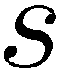
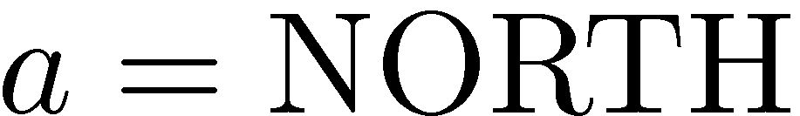
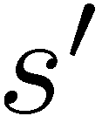
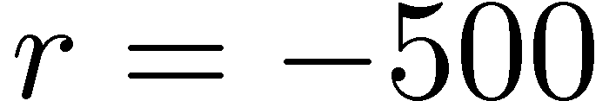
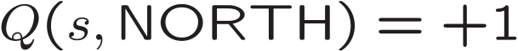
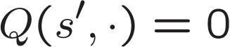
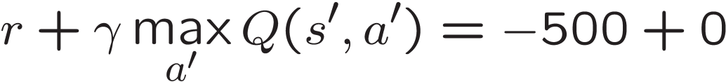
Example: Q-Pacman
[Demo: approximate Q-learning pacman (L11D10)]
Notes:
Here’s an example of Q-learning with feature based approximation being applied to pacman.
Here’s a very simple representation. It’s a combination of two features – the reciprocal of my distance to a dot, and the reciprocal of my distance to a ghost.
So when I get closer to a Ghost, F sub Ghost gets bigger.
I’ve already learned that dots are good and ghosts are bad.
What happens when I have an experience? Here’s a state, and the values of the features.
When we plus these into the Q function, we compute that this state, plus action north is this value (+1).
Then what happens? You move north and you die, and you receive a negative reward. -500 plus a future discounted reward of zero, since the game ended.
So the difference is -501. So I need to update it by the this difference,
I modify that by the LEARNING RATE ALPHA.
I also modify the F_GHOST more since it was more active here.
So when I plug those values in, I get something like this. Alpha is something very small, like 0.005.

Slide 10
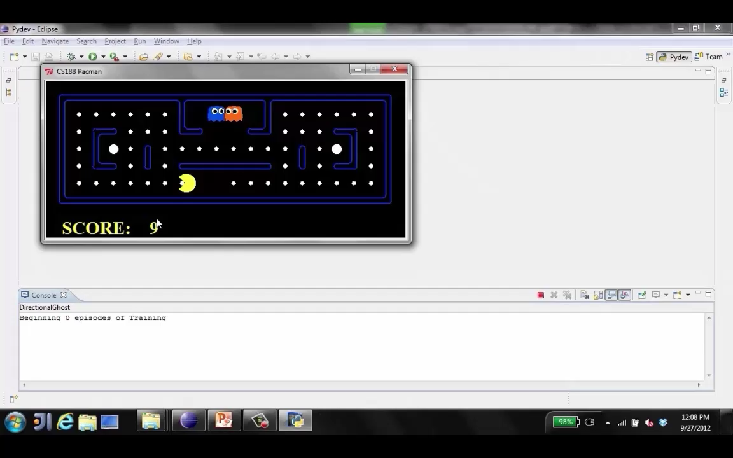
Video of Demo Approximate Q-Learning -- Pacman
Notes:
Let’s see a demo.

Slide 11
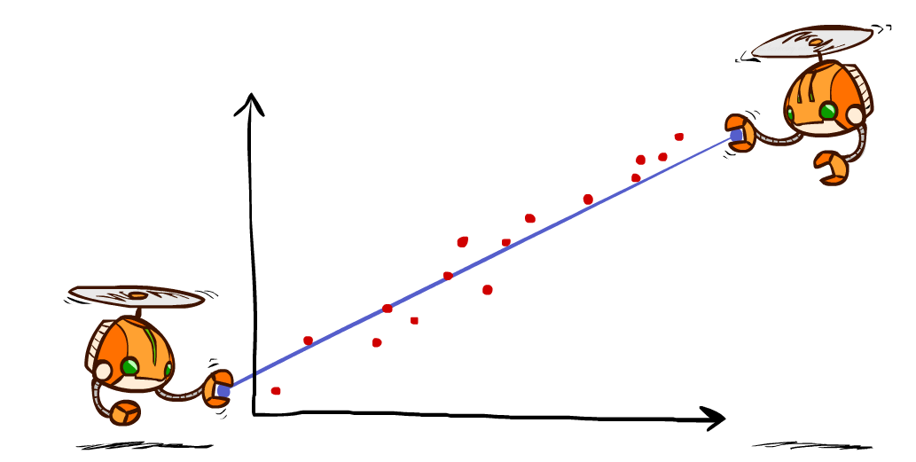
Q-Learning and Least Squares
Notes:
We’re going to take a quick look to see why this update makes sense. We can formally justify the approximate q-learning updates with least squares.

Slide 12
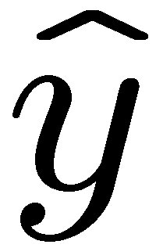
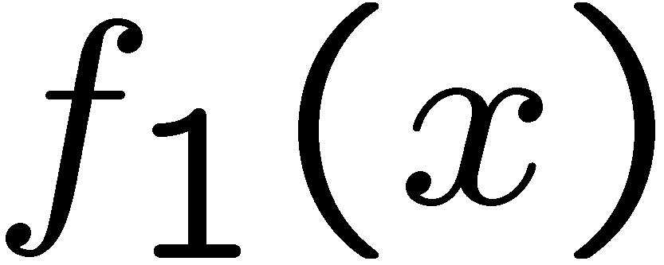
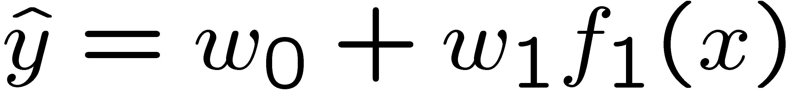
Linear Approximation: Regression*
40
26
24
20
22
20
30
20
40
0
0
20
30
10
20
0
10
0
Prediction:
Prediction:
Notes:
We can have a prediction function which is linear.
W0 is an intercept term, which corresponds to a bias feature that we’ll always set to 1.
Here we only have 1 real feature f_1.
The prediction is Y hat.
This can happen in multiple dimensions. The dimensionality increases with the number of features.
How do we find good values for the features, given a bunch of data points? No q-learning, no robots, just in general.
Figure 1: scatter(1:20,10+(1:20)+2*randn(1,20),'k','filled'); a=axis; a(3)=0; axis(a);

Slide 13
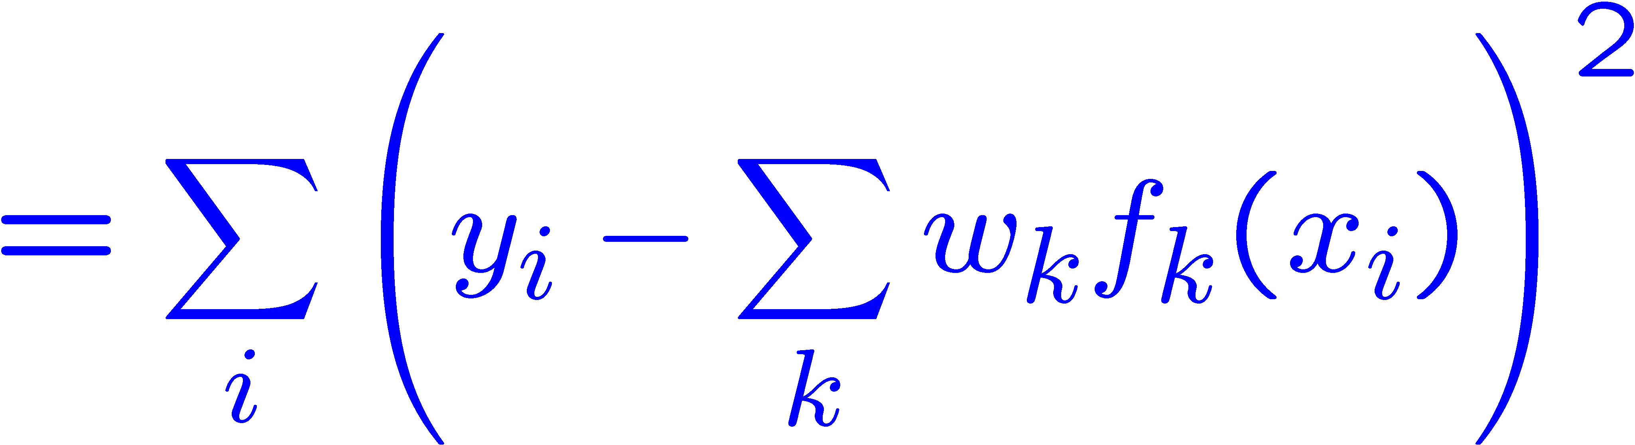
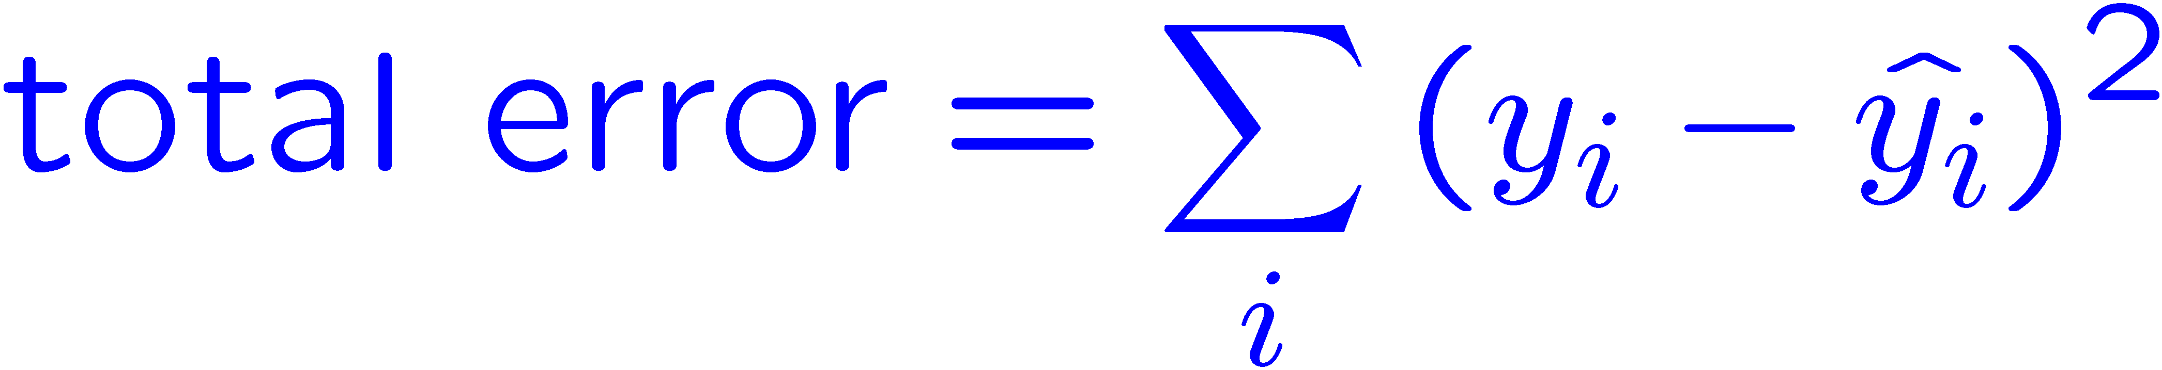
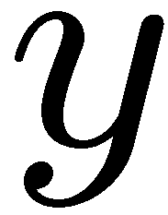
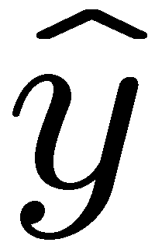

Optimization: Least Squares*
Error or “residual”
Observation
Prediction
0
0
20
Notes:
I’ve got some prediction Y HAT that is determined by the weights. Better weights will get us closer to the true observation Y.
We can quanitfy how wrong we are with one set of weights as the sum of the differences between our predictions and the truth. We square it because being off in the positive or negative directions are both bad.
Then our predictions can be expressed in terms of the K features in this linear form with the features of X.
We should move the weights to make this error small. This is how we derive the formula for linear regression.

Slide 14
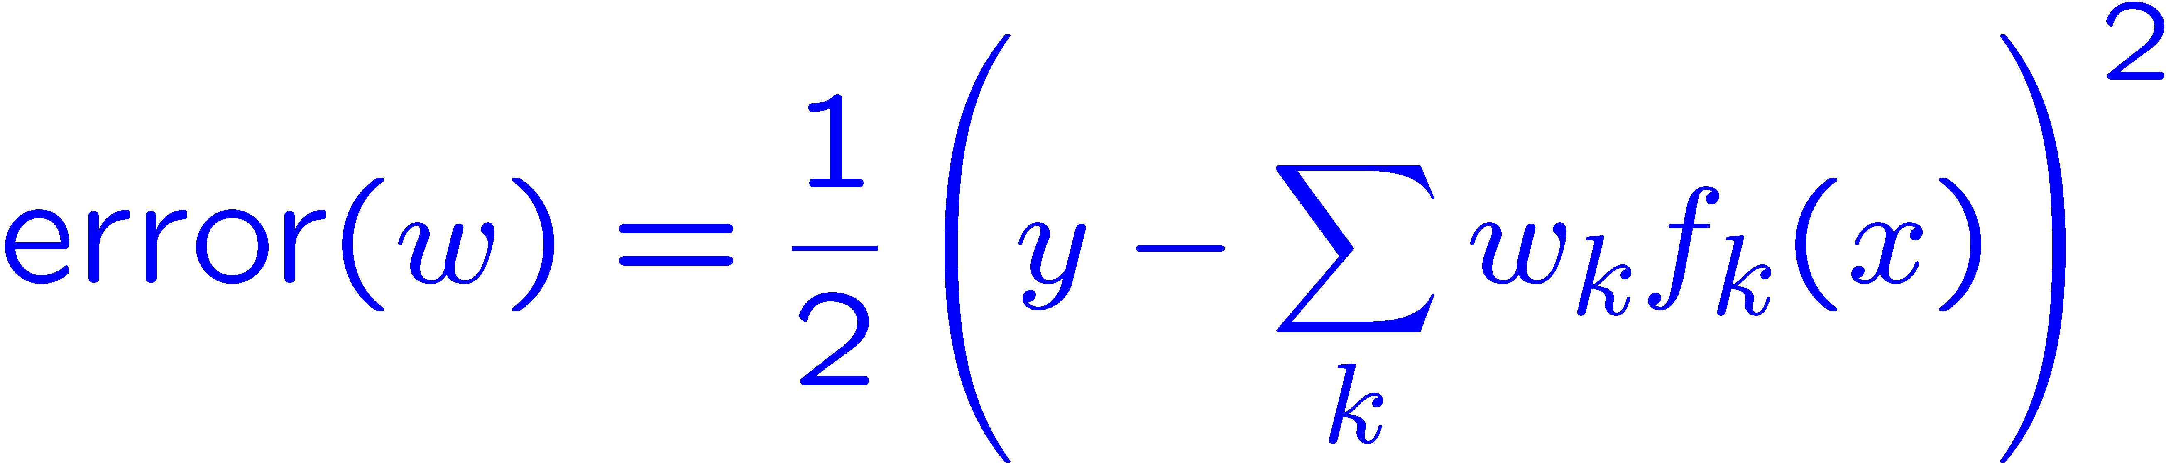
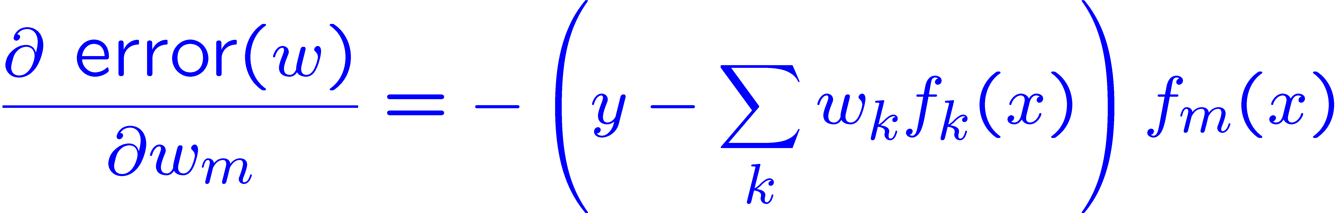
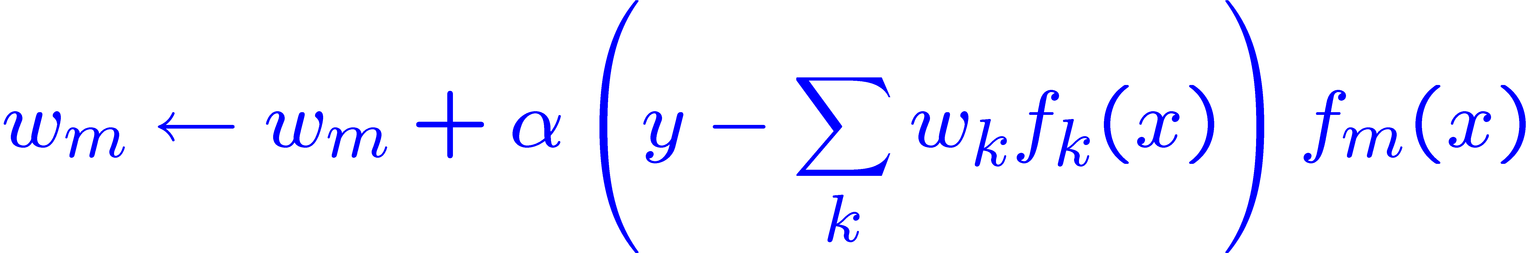
Minimizing Error*
Imagine we had only one point x, with features f(x), target value y, and weights w:
Approximate q update explained:
“target”
“prediction”
Notes:
Here’s how we can write out the error on just one point.
It’s the difference between the truth and the prediction.
Then we stick a ½ in front of it. That doesn’t do anything, but it will help us with the calculus in the next step.
We take a derivative with respect to a certain weight.
Then the derivative of the error is this expression. To make the error big, go in the direction of the feature weights that are making this wrong.
So we want to minimize the error, so we update the weights with the inverse of that.
And that’s how we explain the form of the q-update. Where instead of Y, we have the observed reward, and instead of the prediction Y HAT, we have our previous prediction Q(S,A)
Online least suqares.

Slide 15
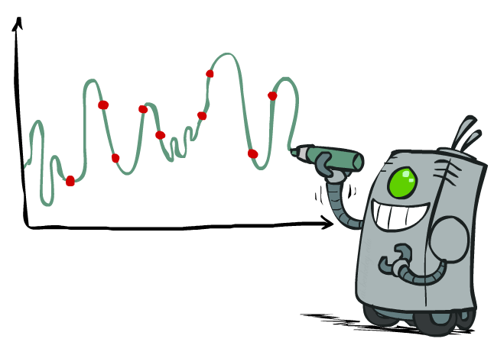
Overfitting: Why Limiting Capacity Can Help*
30
25
20
Degree 15 polynomial
15
10
5
0
-5
-10
-15
0
2
4
6
8
10
12
14
16
18
20
Notes:
Why linear? Why a small amount of features? It’s to avoid overfitting. With a 15 degree polynomial, you can draw a complex squiggle to connect all of the points like this. This will give you an exact prediction on your training items, but probably a terrible prediction for future test points.

Slide 16
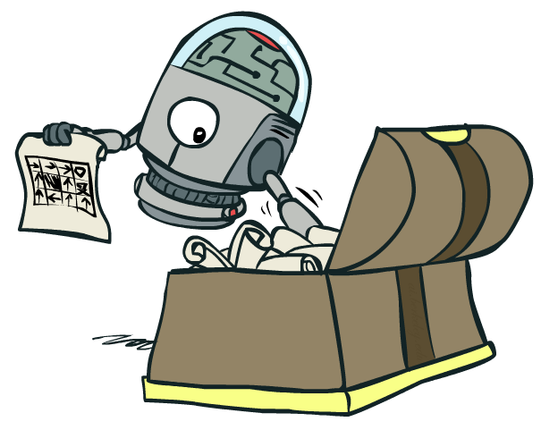
Policy Search
Notes:
One last important thing about how these things work in practice.
Q-learning will only take us so far, so in practice people do something a bit different called policy search.

Slide 17
Policy Search
Problem: often the feature-based policies that work well (win games, maximize utilities) aren’t the ones that best approximate the Q-values
Q-learning’s priority: get Q-values close (modeling)
Action selection priority: get ordering of Q-values right (prediction)
We’ll see this distinction between modeling and prediction again later in the course
Solution: learn policies that maximize rewards, not the values that predict them
Policy search: start with an ok solution (e.g. Q-learning) then fine-tune by hill climbing on feature weights
Notes:
The problem with Q-learning is that we’re trying to get the values close to the truth. It doesn’t try to order the values. In selection an action, we really only care about the difference between the best choice and the others.
The solution to this is to learn policies policies that maximize rewards, not the values that predict them.
Policy search might start with Q-learning. Then hill climb on the feature weights.

Slide 18
Policy Search
Simplest policy search:
Start with an initial linear value function or Q-function
Nudge each feature weight up and down and see if your policy is better than before
Problems:
How do we tell the policy got better?
Need to run many sample episodes!
If there are a lot of features, this can be impractical
Better methods exploit look ahead structure, sample wisely, change multiple parameters…
Notes:
Here’s the simplest way to do policy search.
Start with something in the ball park, and then nudge the feature weights to see if we get a better policy. We don’t actually have to do Q-learning or its look aheads.

Slide 19
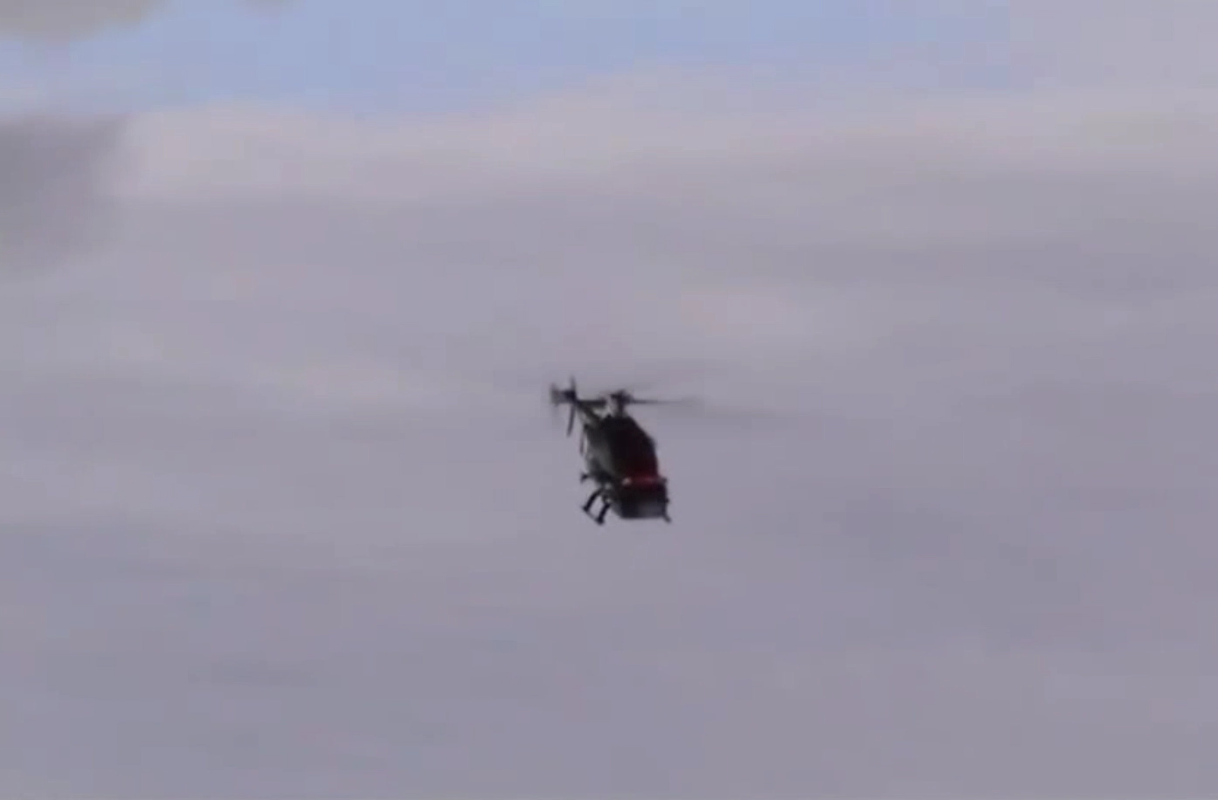
Policy Search
Notes:
Here’s the simplest way to do policy search.
Start with something in the ball park, and then nudge the feature weights to see if we get a better policy. We don’t actually have to do Q-learning or its look aheads.

Slide 20
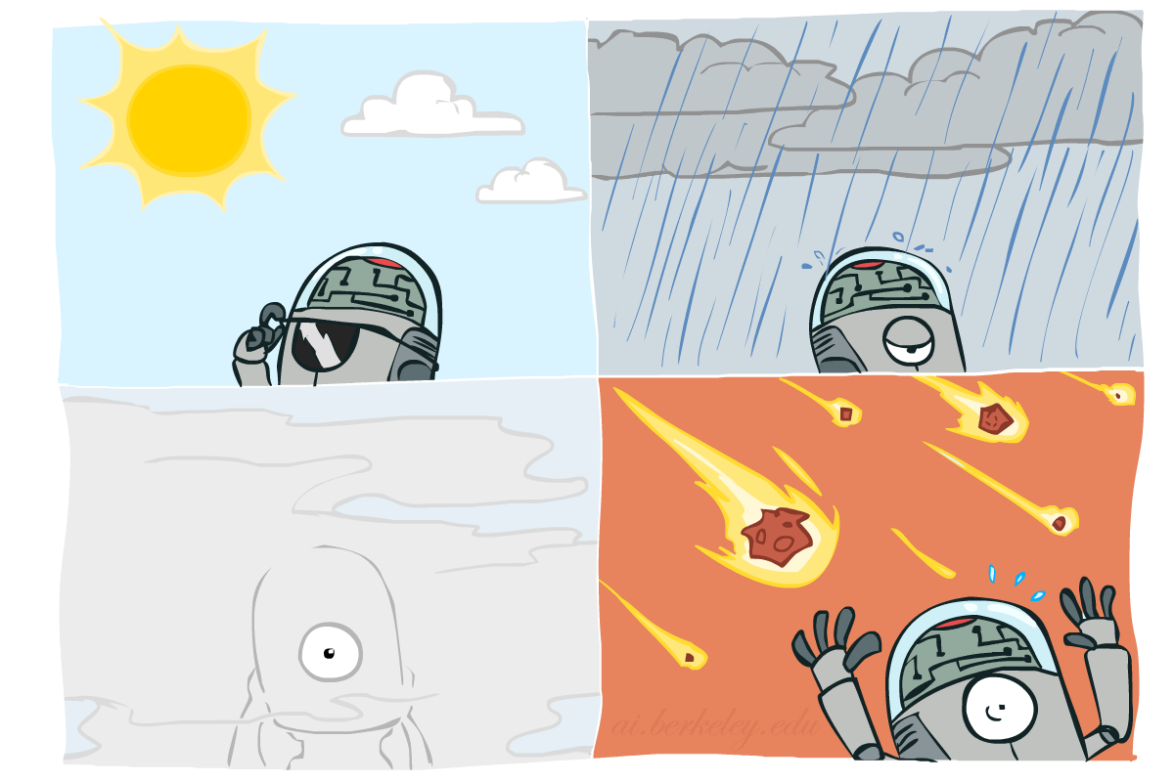
Probability
Slides courtesy of Dan Klein and Pieter Abbeel – University of California, Berkeley
[These slides were created by Dan Klein and Pieter Abbeel for CS188 Intro to AI at UC Berkeley. All CS188 materials are available at http://ai.berkeley.edu.]
Notes:
Please retain proper attribution, including the reference to ai.berkeley.edu. Thanks!

Slide 21
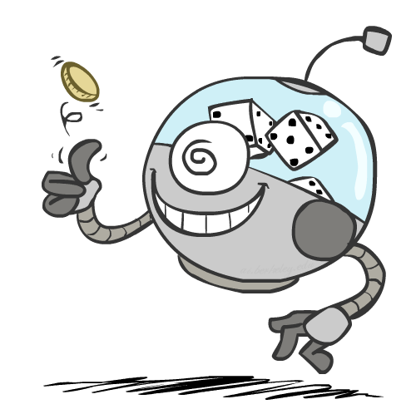
Today
Probability
Random Variables
Joint and Marginal Distributions
Conditional Distribution
Product Rule, Chain Rule, Bayes’ Rule
Inference
Independence
You’ll need all this stuff A LOT for the next few weeks, so make sure you go over it now! Read AIMA 13.1-13.5.
Notes:
Hopefully this is a refresher for many of you.

Slide 22
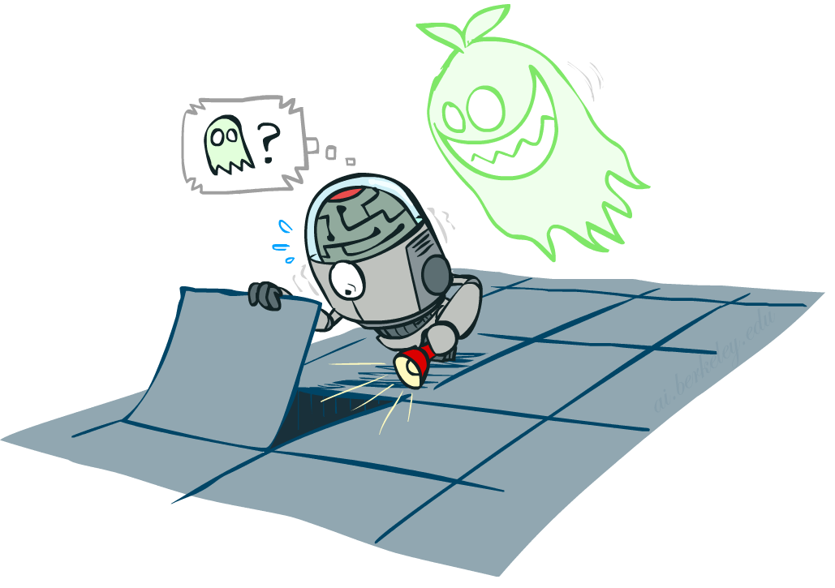
Uncertainty
General situation:
Observed variables (evidence): Agent knows certain things about the state of the world (e.g., sensor readings or symptoms)
Unobserved variables: Agent needs to reason about other aspects (e.g. where an object is or what disease is present)
Model: Agent knows something about how the known variables relate to the unknown variables
Probabilistic reasoning gives us a framework for managing our beliefs and knowledge

Slide 23
Random Variables
A random variable is some aspect of the world about which we (may) have uncertainty
R = Is it raining?
T = Is it hot or cold?
D = How long will it take to drive to work?
L = Where is the ghost?
We denote random variables with capital letters
Like variables in a CSP, random variables have domains
R in {true, false} (often write as {+r, -r})
T in {hot, cold}
D in [0, ∞)
L in possible locations, maybe {(0,0), (0,1), …}
Notes:
We are going to deal with discrete random variables, rather than continuous ones. In continuous you deal with integrals rather than summations.

Slide 24
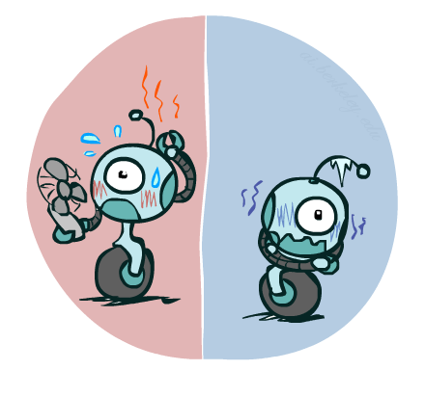
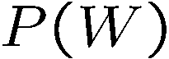
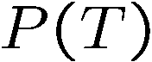
Probability Distributions
Associate a probability with each value
Temperature:
Weather:
W | P
sun | 0.6
rain | 0.1
fog | 0.3
meteor | 0.0
T | P
hot | 0.5
cold | 0.5
Notes:
Possible variable in the domain. For weather we probably don’t want to include a variable with probability 0.

Slide 25

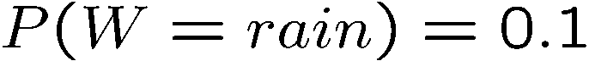
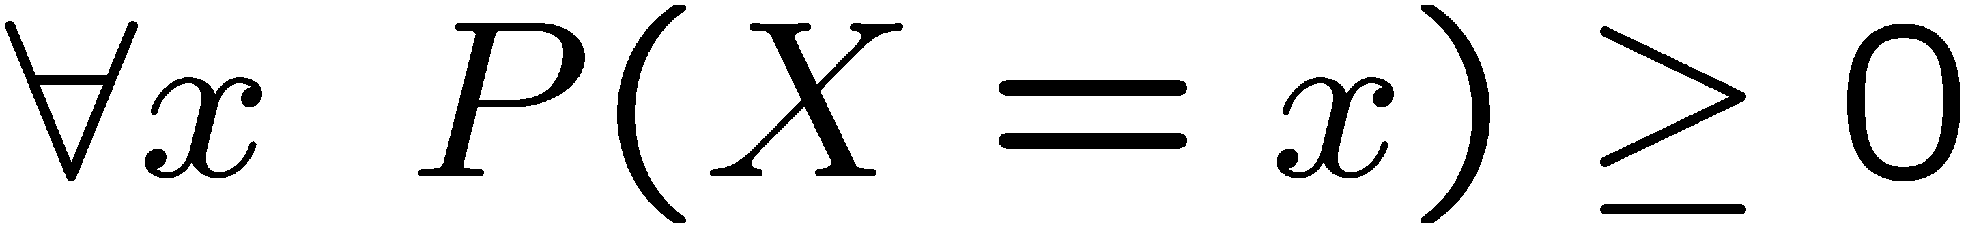
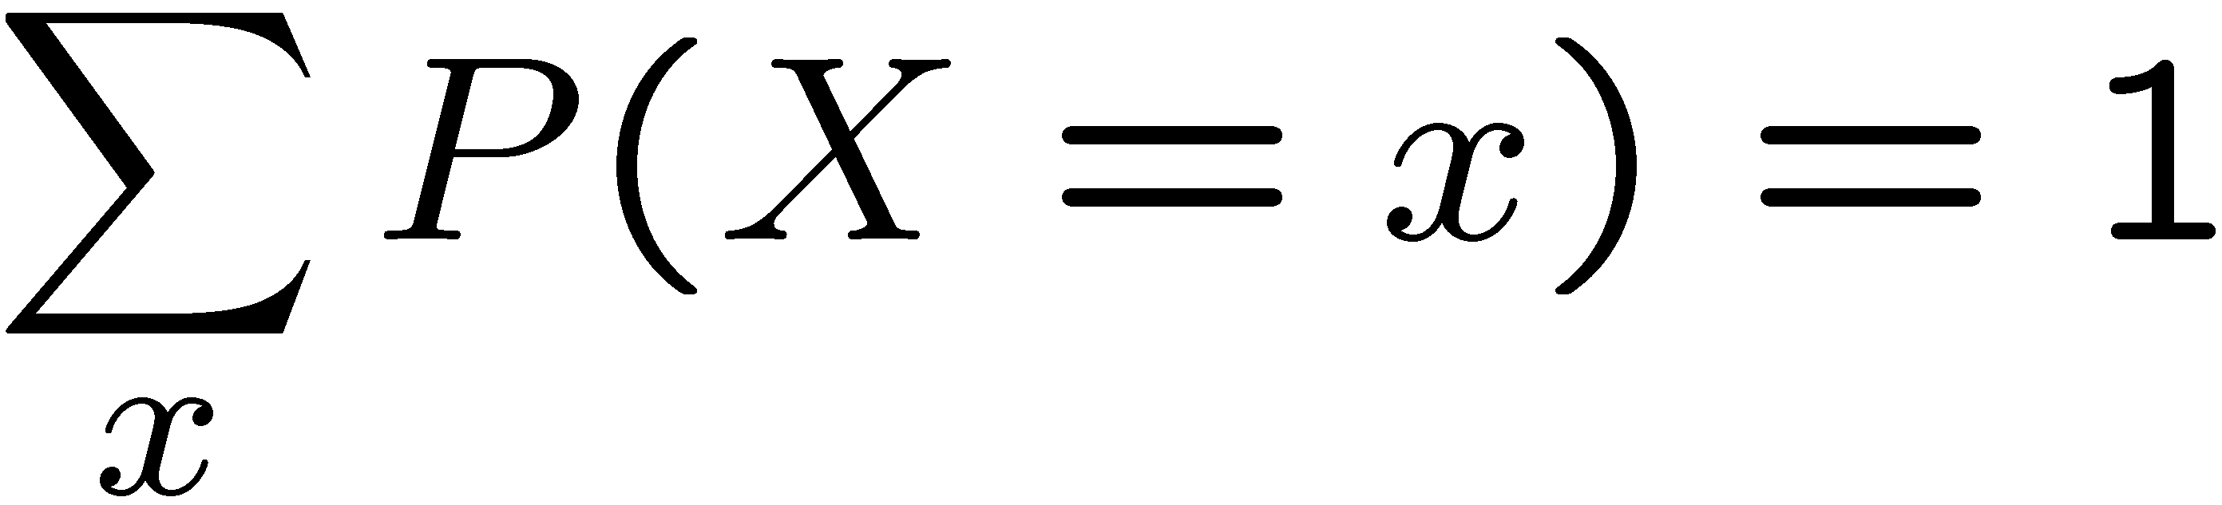
Probability Distributions
Unobserved random variables have distributions
A distribution is a TABLE of probabilities of values
A probability (lower case value) is a single number
Must have: and
Shorthand notation:
OK if all domain entries are unique
T | P
hot | 0.5
cold | 0.5
W | P
sun | 0.6
rain | 0.1
fog | 0.3
meteor | 0.0

Slide 26
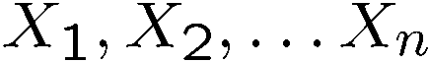
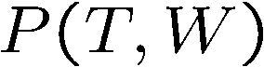
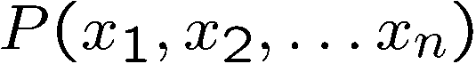
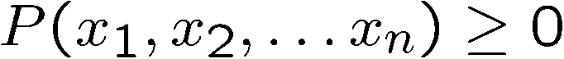
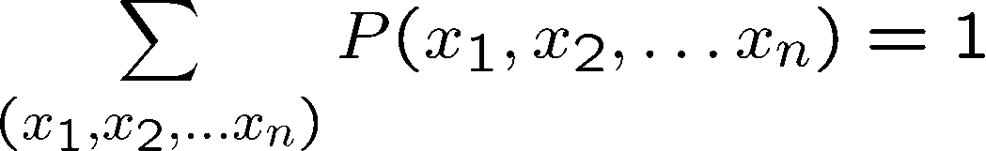
Joint Distributions
A joint distribution over a set of random variables:
specifies a real number for each assignment (or outcome):
Must obey:
Size of distribution if n variables with domain sizes d?
For all but the smallest distributions, impractical to write out!
T | W | P
hot | sun | 0.4
hot | rain | 0.1
cold | sun | 0.2
cold | rain | 0.3
Notes:
N*D? No.
D^N? Yes.
In the next lectures we’re going to see how to work with how to deal with large sets of variables.

Slide 27

Probabilistic Models
Distribution over T,W
A probabilistic model is a joint distribution over a set of random variables
Probabilistic models:
(Random) variables with domains
Assignments are called outcomes
Joint distributions: say whether assignments (outcomes) are likely
Normalized: sum to 1.0
Ideally: only certain variables directly interact
Constraint satisfaction problems:
Variables with domains
Constraints: state whether assignments are possible
Ideally: only certain variables directly interact
T | W | P
hot | sun | 0.4
hot | rain | 0.1
cold | sun | 0.2
cold | rain | 0.3
Constraint over T,W
T | W | P
hot | sun | T
hot | rain | F
cold | sun | F
cold | rain | T

Slide 28
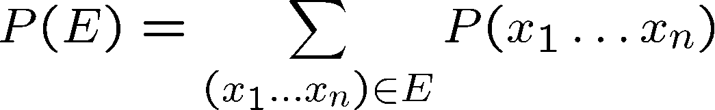
Events
An event is a set E of outcomes
From a joint distribution, we can calculate the probability of any event
Probability that it’s hot AND sunny?
Probability that it’s hot?
Probability that it’s hot OR sunny?
Typically, the events we care about are partial assignments, like P(T=hot)
T | W | P
hot | sun | 0.4
hot | rain | 0.1
cold | sun | 0.2
cold | rain | 0.3
Notes:
An event is a set of possible outcomes. We compute these by summing over all subsets of variables that are compatible with that event. These are subsets of variables.
Let’s say x1=true, then if you sum over all entries in the joint table with x1…xN, where the entry says x=1 is true then you get the probability that x=1 true.
Events don’t have to be as simple as x1=true. It could be x1=true and x2=false. Or more combinations of variables coule be involved.
Look at all of the entries that are consistent with the event.
Probability that it’s hot AND sunny? 0.4
Probability that it’s hot? 0.5
Probability that it’s hot OR sunny? 0.2

Slide 29
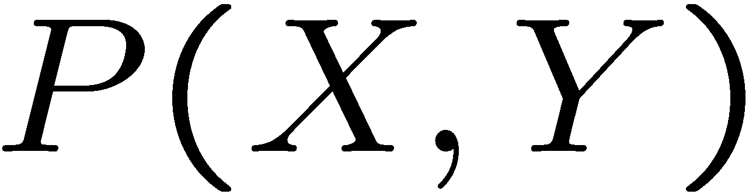
Quiz: Events
P(+x, +y) ?
P(+x) ?
P(-y OR +x) ?
X | Y | P
+x | +y | 0.2
+x | -y | 0.3
-x | +y | 0.4
-x | -y | 0.1
Notes:
P(+x, +y) ? 0.2
P(+x) ? 0.5
P(-y OR +x) ? 0.6

Slide 30
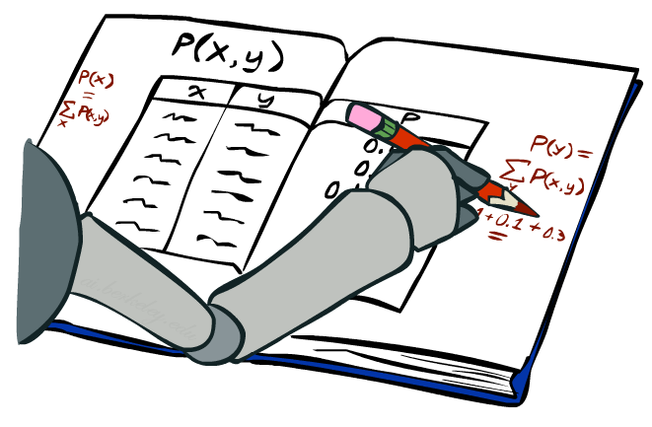
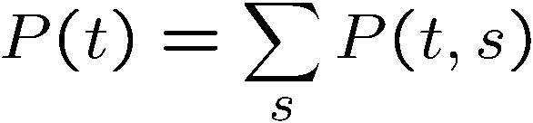
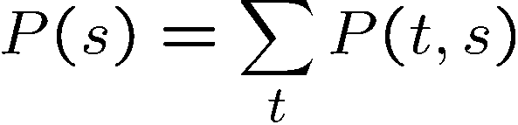
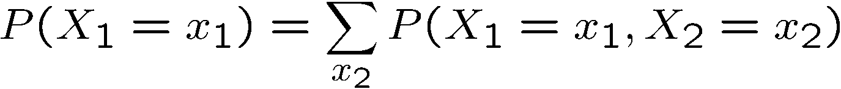
Marginal Distributions
Marginal distributions are sub-tables which eliminate variables
Marginalization (summing out): Combine collapsed rows by adding
T | P
hot | 0.5
cold | 0.5
T | W | P
hot | sun | 0.4
hot | rain | 0.1
cold | sun | 0.2
cold | rain | 0.3
W | P
sun | 0.6
rain | 0.4
Notes:
Marginalize distribution means you build a new table for a subset of random variables.
This is the general equation. You can apply it to any number of random variables. If you had 3 random varaibles, you could compute the marginals for
Just x1
Just x2
Just x3
x1 and x2
x2 and x3
x1 and x3

Slide 31




Quiz: Marginal Distributions
X | P
+x
-x
X | Y | P
+x | +y | 0.2
+x | -y | 0.3
-x | +y | 0.4
-x | -y | 0.1
Y | P
+y
-y
Notes:
+x 0.5
-x 0.5
+y 0.6
-y 0.4
Good sanity check is to make sure that the numbers sum to 1.

Slide 32






Conditional Probabilities
A simple relation between joint and conditional probabilities
In fact, this is taken as the definition of a conditional probability
P(a,b)
P(a)
P(b)
T | W | P
hot | sun | 0.4
hot | rain | 0.1
cold | sun | 0.2
cold | rain | 0.3
Notes:
This is the most important concept. Why because it tells us, if we measure something, what does it tell us about the things that we didn’t get to measure. That’s what conditional probabilities come in.
A conditional probability that random variable Capital A will take on value lowercase a, given that random variable Capital B takes on value lowercase b. This is given by the probability of seeing both a and b, divided by the probability of seeing b.
[Explain the Venn diagram.]
Write out the equation for P(sun|cold)

Slide 33
Quiz: Conditional Probabilities
P(+x | +y) ?
P(-x | +y) ?
P(-y | +x) ?
X | Y | P
+x | +y | 0.2
+x | -y | 0.3
-x | +y | 0.4
-x | -y | 0.1
Notes:
P(+x | +y) = 0.2 / 0.6 = 1/3
P(-x | +y) ? = 0.4 / 0.6 = 2/3 ( = 1 – P(+x|+y) = 2/3
P(-y | +x) ? P(-y, +x) / P(+x) = 0.3 / 0.5 = 0.6

Slide 34



Conditional Distributions
Conditional distributions are probability distributions over some variables given fixed values of others
Conditional Distributions
Joint Distribution
W | P
sun | 0.8
rain | 0.2
T | W | P
hot | sun | 0.4
hot | rain | 0.1
cold | sun | 0.2
cold | rain | 0.3
W | P
sun | 0.4
rain | 0.6
Notes:
Before we saw how to go from a joint distribution to a marginal distribution. Now we’re going to see how to go from a joint distribution to a conditional.
A conditional distribution is a consequence of the joint distribution. We do that just like we did on the previous slide).
P(W|T) is a set of tables that can be extracted from the joint distribution P(T, W).

Slide 35








Normalization Trick
T | W | P
hot | sun | 0.4
hot | rain | 0.1
cold | sun | 0.2
cold | rain | 0.3
W | P
sun | 0.4
rain | 0.6
Notes:
CCB – start here
Another way of arriving at a conditional distribution from a joint distribution is called the Normalization trick. It can be faster, and is a bit more mechanical than before. The idea is to go from a full joint to a conditional in a very structured way.
First, let’s look at what happens when we do what we did before. We need two entries in the conditional probability weather, given temperature is cold.
p(sunny |cold)
p(rain| cold).
[Write these on the board.]
Now, let’s take a careful look at what is happening here. What entries are we using in the two equations? All the entries which are consistent with T=c. The way that they show up is that ALL OF THEM SHOW UP IN THE DENOMINATOR. The one on the top is the one that is consistent with the row that we’re computing.
Another way of looking at this is to look up all entries that are consistent with T=c, and then use them in a particular way. We just need the one entry that’s consistent with what we’re doing, and then we need all of them for the denominator.

Slide 36

Normalization Trick
SELECT the joint probabilities matching the evidence
NORMALIZE the selection
(make it sum to one)
T | W | P
hot | sun | 0.4
hot | rain | 0.1
cold | sun | 0.2
cold | rain | 0.3
T | W | P
cold | sun | 0.2
cold | rain | 0.3
W | P
sun | 0.4
rain | 0.6
Notes:
So let’s look at that in a different way.
First, select all of the entries that are consistent with T=c.
Then we need the one that’s consistent with what we’re computing (W=sun or W=rain), and then divide by the sum of all of the values that we selected.
That’s called normalization. We just want to make it sum to one by dividing by the sum of all the entries that we selected from the joint table.
This can make it easier to compute.

Slide 37

Normalization Trick
SELECT the joint probabilities matching the evidence
NORMALIZE the selection
(make it sum to one)
T | W | P
hot | sun | 0.4
hot | rain | 0.1
cold | sun | 0.2
cold | rain | 0.3
T | W | P
cold | sun | 0.2
cold | rain | 0.3
W | P
sun | 0.4
rain | 0.6
Why does this work? Sum of selection is P(evidence)! (P(T=c), here)

Slide 38
Quiz: Normalization Trick
P(X | Y=-y) ?
SELECT the joint probabilities matching the evidence
NORMALIZE the selection
(make it sum to one)
X | Y | P
+x | +y | 0.2
+x | -y | 0.3
-x | +y | 0.4
-x | -y | 0.1
Notes:
P(X | Y=-y)
Select
+x, -y, 0.3
-x, -y, 0.1
Normalize
+x = 0.3 / 0.4 = 0.75
-x = 0.1 / 0.4 = 0.25

Slide 39
To Normalize
(Dictionary) To bring or restore to a normal condition
Procedure:
Step 1: Compute Z = sum over all entries
Step 2: Divide every entry by Z
Example 1
All entries sum to ONE
Example 2
W | P
sun | 0.2
rain | 0.3
Normalize
W | P
sun | 0.4
rain | 0.6
T | W | P
hot | sun | 20
hot | rain | 5
cold | sun | 10
cold | rain | 15
T | W | P
hot | sun | 0.4
hot | rain | 0.1
cold | sun | 0.2
cold | rain | 0.3
Normalize
Z = 0.5
Z = 50
Notes:
What does this term mean? …
In Example 2, the numbers are too large to be probabilities, but normalization corrects this.

Slide 40

Probabilistic Inference
Probabilistic inference: compute a desired probability from other known probabilities (e.g. conditional from joint)
We generally compute conditional probabilities
P(on time | no reported accidents) = 0.90
These represent the agent’s beliefs given the evidence
Probabilities change with new evidence:
P(on time | no accidents, 5 a.m.) = 0.95
P(on time | no accidents, 5 a.m., raining) = 0.80
Observing new evidence causes beliefs to be updated
Notes:
What is probabilistic inference in general? It’s computing some desired probabilities (usually conditionals), given some input set of probabilities (by default, a large joint distribution).
The reason that this is interesting, is that our probability distributions change as we accrue more evidence.
Observing new evidence causes our beliefs to be updated. Evidence can cause the probabilities to go up or to go down.

Slide 41











Inference by Enumeration
* Works fine with multiple query variables, too
General case:
Evidence variables:
Query* variable:
Hidden variables:
We want:
All variables
Step 1: Select the entries consistent with the evidence
Step 2: Sum out H to get joint of Query and evidence
Step 3: Normalize
Notes:
Here’s the first procedure that we’ll look at for Probabilistic Inference. It is called Inference by Enumeration
We can split up our variables into 3 sets:
1. some evidence variables – those are what we’ve observed.
2. The query variables – those are what we want to know about
3. The hidden variables – those appear in the joint distribution, but don’t appear in the previous 2.
Here are the 3 steps that we need to do:
Step 1: select all entries that are consistent with the Evidence.
Step 2: Sum out the hidden variables. Sum over all possible instantiations of the hidden variables. That leaves us with the joint distribution between the query variable and the evidence variables.
That’s something like P(a, c) = sum over b P(a,b,c).
That’s the same as P(q, e) = sum over h P(q,h,e).
Step 3: Normalize to get the conditional probability.

Slide 42
Inference by Enumeration
P(W)?
P(W | winter)?
P(W | winter, hot)?
S | T | W | P
summer | hot | sun | 0.30
summer | hot | rain | 0.05
summer | cold | sun | 0.10
summer | cold | rain | 0.05
winter | hot | sun | 0.10
winter | hot | rain | 0.05
winter | cold | sun | 0.15
winter | cold | rain | 0.20
Notes:
Work through these on the board.

Slide 43
Inference by Enumeration
Obvious problems:
Worst-case time complexity O(d^{n})
Space complexity O(d^{n}) to store the joint distribution
Notes:
Size of distribution if n variables with domain sizes d

Slide 44



The Product Rule
Sometimes have conditional distributions but want the joint
Notes:
The product rule is directly derived from our definition of the conditional probability.
Just multiply both sides by the marginal.
What’s interesting here is that this is our first encounter of how to arrive at a joint distribution not by specifying the full distribution in advance, but by specifying the marginal and the joint distribution. This implicitly gives us a joint.

Slide 45


The Product Rule
Example:
D | W | P
wet | sun | 0.1
dry | sun | 0.9
wet | rain | 0.7
dry | rain | 0.3
D | W | P
wet | sun | 0.08
dry | sun | 0.72
wet | rain | 0.14
dry | rain | 0.06
R | P
sun | 0.8
rain | 0.2
Notes:
How do recover the full joint distribution?
P(wet, sun) =. P(sun) * P(wet | sun) = 0.8 * 0.1 = 0.08
P(dry, sun) =. P(sun) * P(dry| sun) = 0.8 * 0.9 = 0.72
…
We can compute every entry that way.

Slide 46

The Chain Rule
More generally, can always write any joint distribution as an incremental product of conditional distributions
Why is this always true?
Notes:
Can we apply the product rule to more than two variables? Yes! It’s called the chain rule.
Here’s the chain rule for 3 variables, x1, x2, x3. It’s the maginal of x1, times the conditional of x2 given x1, times the conditional of x3 given x1 and x2.
We can generalize this to any number of x1 to x_n as ….
i = 1 P(x1)
I = 2 p(x2|x1)
I = 3 p(x3|x1, x2)
…
I = n p(x_n|x1, x2, …. Xn-1)
Then you take the product of all of those. You can take any ordering and still apply this chain rule. There are n! ways of writing the joint over the ordering of n variables.
Why is this always true? [Write out the equations for P(x1,x2,x3) replacing each conditional with its joint over marginal equivalent and show how the cancel.).
P(x1) * P(x2|x1) * p(x3|x2,x1) rewrites as P(x1) * P(x2,x1)/P(x1) * p(x3,x2,x1)/p(x2,x1).
Show the cancelation of each numerator and the next term’s denominator.
That leaves p(x3,x2,x1).
If you want, you can prove this by induction.

Slide 47

Bayes Rule
Notes:
Now let’s look at what we’ll often be doing. We’ll be given a distribution, not as a full joint distribution but in some other format.
And we want to slice and dice that to get to the representation that we really want.

Slide 48




Bayes’ Rule
Two ways to factor a joint distribution over two variables:
Dividing, we get:
Why is this at all helpful?
Lets us build one conditional from its reverse
Often one conditional is tricky but the other one is simple
Foundation of many systems we’ll see later (e.g. ASR, MT)
In the running for most important AI equation!
Notes:
We start with the product rule. Just like the chain rule you can write the variables in any order.
Next we divide by p(y) to get this formula for the conditional probability.
Why is this helpful? Sometimes one conditional is much trickier to get than it is to get other conditionals.
Very imporant for AI in the 1990s. In fact Fred Jelinek, my former boss at JHU, dubbed it the fundamental equation of machine translation.
Generalizations of this will be what we study in the next few lectures.

Slide 49
Inference with Bayes’ Rule
Example: Diagnostic probability from causal probability:
Example:
M: meningitis, S: stiff neck
Note: posterior probability of meningitis still very small
Note: you should still get stiff necks checked out! Why?
Example
givens
Notes:
What’s the probability that meningitis is the cause, given that we have the effect of a stiff neck? The equation equation works out to be 0.007944 or a bit less than 1%.
This can be used to make decisions? Should a person with a stiff neck go to the doctor? It depends on the probabilities and the utilities. What’s the utility of living with undiagnosed meningitis? What’s the utility of knowing that you don’t have it after going to the doctor and getting a clean bill of health? What’s the utility of living without meningitis, if you go and get it treated?
The cost of undiagnosed meningitis may be high, versus the cost of going to the doctor which may just take a little bit of time.
Meningitis is an inflammation of the membranes (meninges) surrounding your brain and spinal cord.
The swelling from meningitis typically triggers symptoms such as headache, fever and a stiff neck.
Most cases of meningitis in the United States are caused by a viral infection, but bacterial, parasitic and fungal infections are other causes. Some cases of meningitis improve without treatment in a few weeks. Others can be life-threatening and require emergent antibiotic treatment.

Slide 50
Quiz: Bayes’ Rule
Given:
What is P(W | dry) ?
D | W | P
wet | sun | 0.1
dry | sun | 0.9
wet | rain | 0.7
dry | rain | 0.3
R | P
sun | 0.8
rain | 0.2
Notes:
P(W | dry)
Table:
W. P(W|dry)
Sun
Rain
p(sun|dry) = p(dry|sun)*P(sun) / P(dry) … to compute the denominator we need to computer P(dry|sun) * P(sun) + P(dry|rain) * P(rain)
0.9*0.8 / 0.9*0.8 + 0.3*0.2.
P(ran|dry) will just be 1-P(sun|dry).

Slide 51
Next Time: Markov Models

